Slide 1

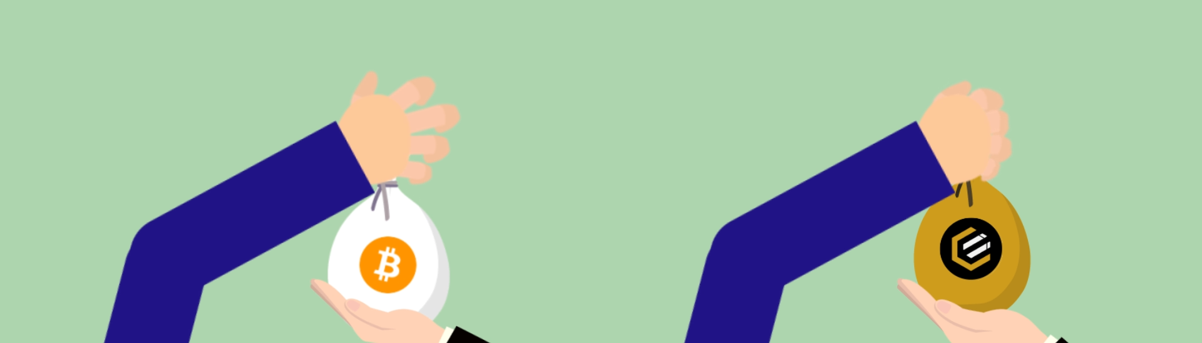
CRYPTORESEARCHIST
How to buy or sell a coin on Vitex Exchange

Slide 2
CRYPTORESEARCHIST
1. Download and sign up for Vite Multi-token Wallet (App):
Click the link in the description to download the Vite App.
https://x.vite.net/vitex_invite_outer/index.html?vitex_invite_code=287323862

Slide 3
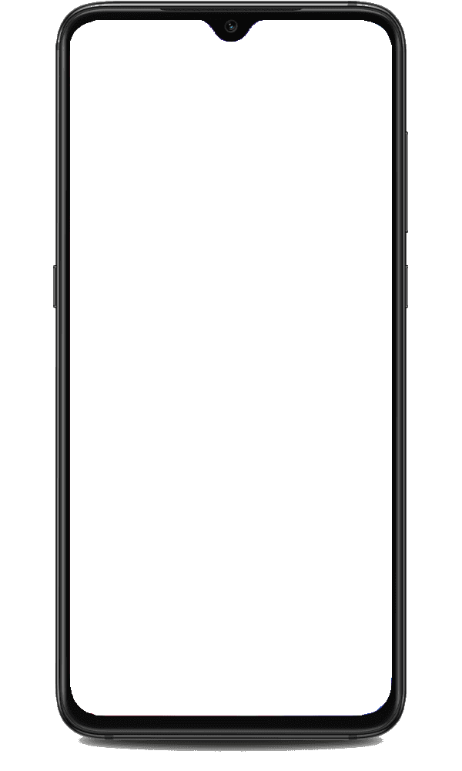

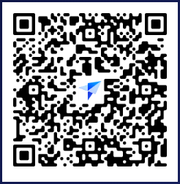
CRYPTORESEARCHIST
You will be presented with a QR like this.
Scan it with Vite App and Accept it or
Scan to Download Vite App.

Slide 4
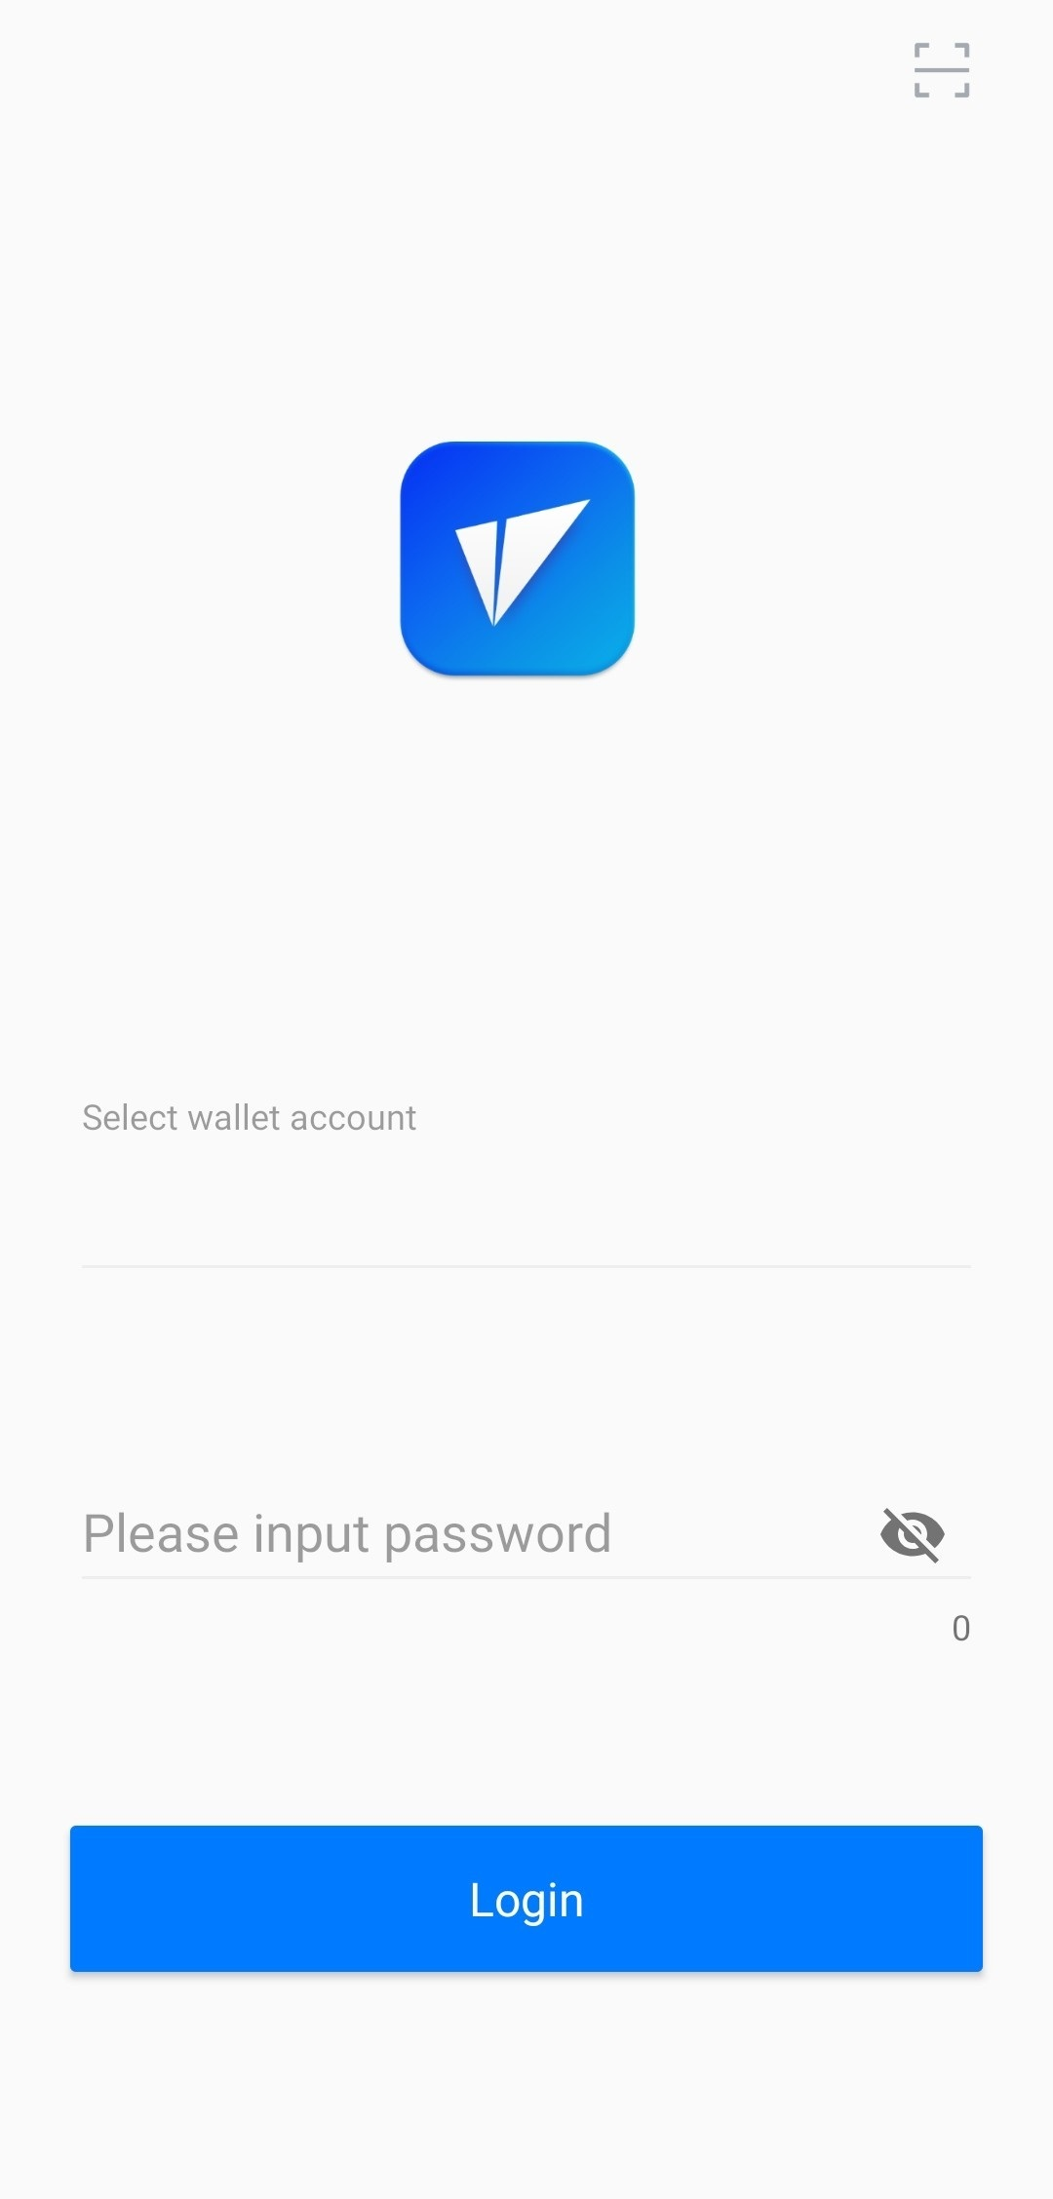
CRYPTORESEARCHIST
2. Log in to your wallet:

Slide 5
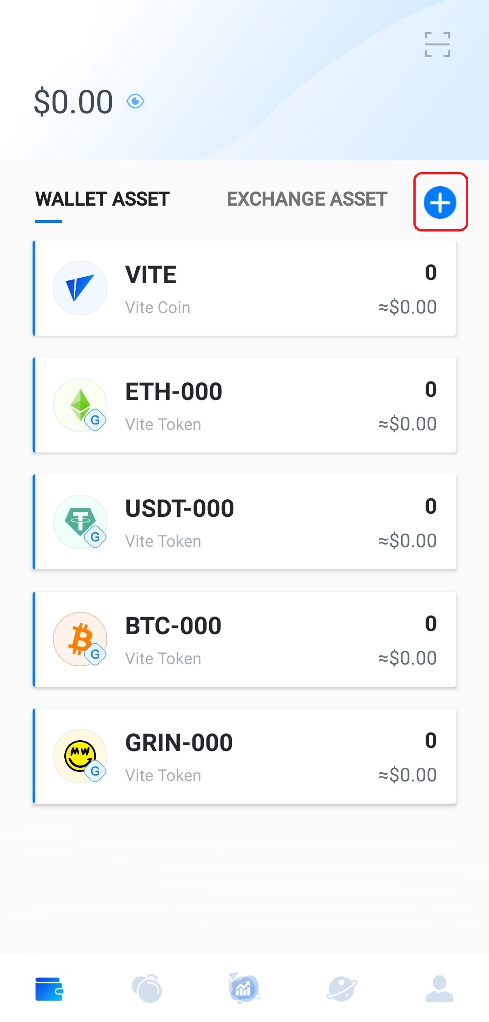
CRYPTORESEARCHIST
3. Tap the “+” button on the upper right corner

Slide 6
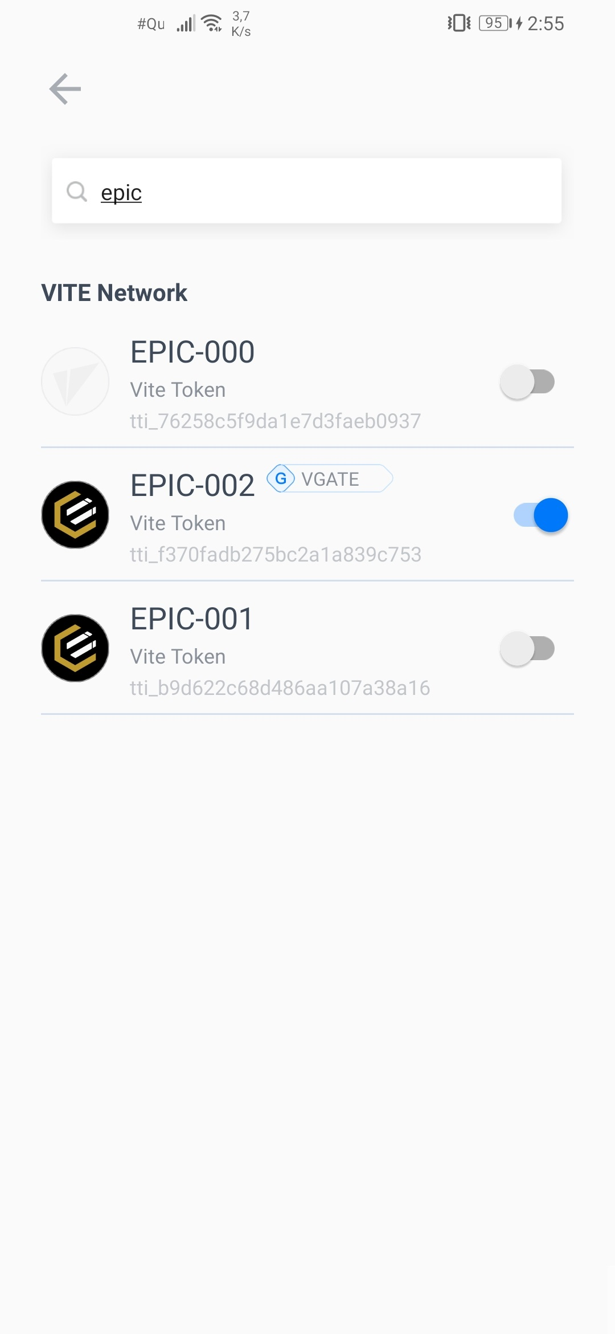
CRYPTORESEARCHIST
And search for EPIC-002 token:
Then, activate it.

Slide 7
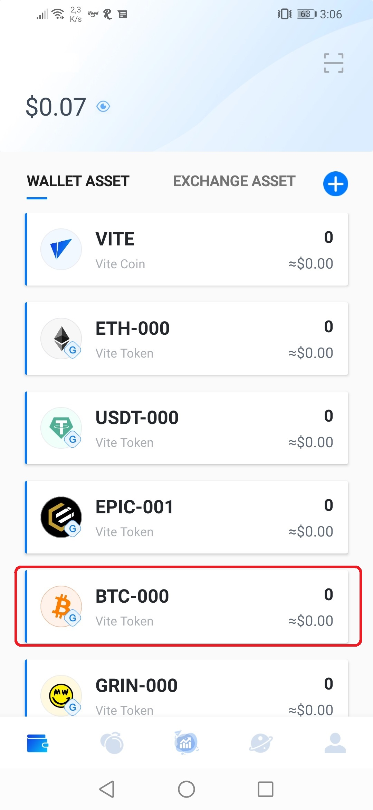
CRYPTORESEARCHIST
4. Go back and tap the BTC-000 WALLET ASSET

Slide 8
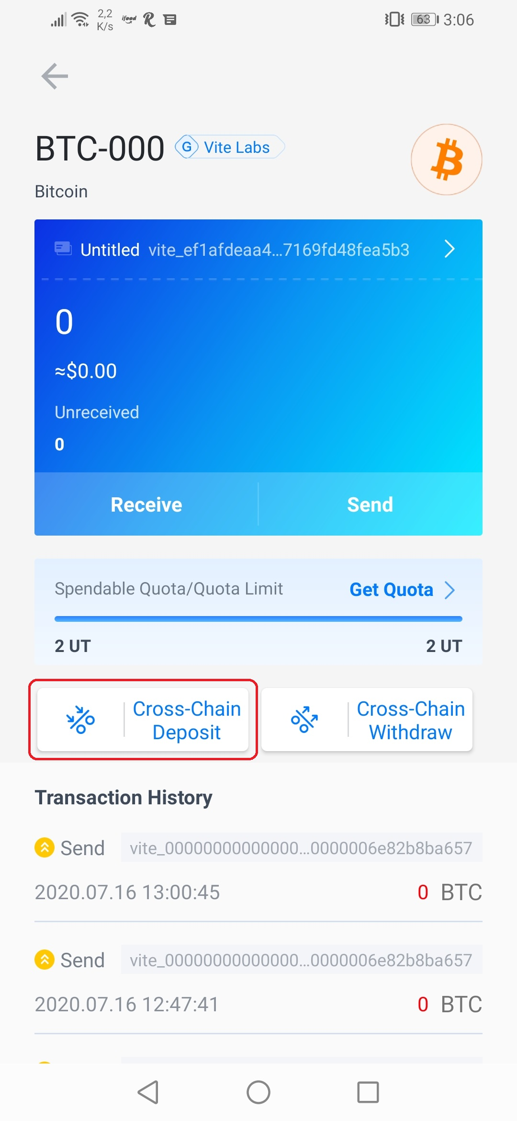
CRYPTORESEARCHIST
Then tap the “Cross-Chain Deposit” button:

Slide 9
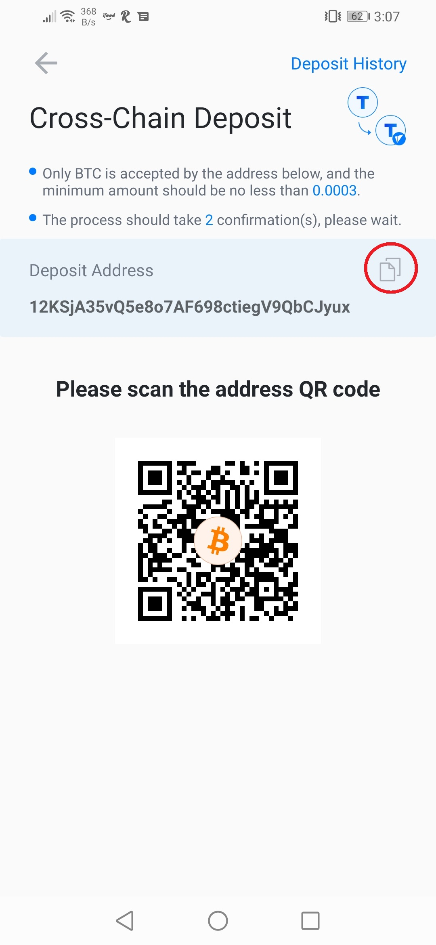
CRYPTORESEARCHIST
5. Tap “Next” And then copy your deposit address:

Slide 10
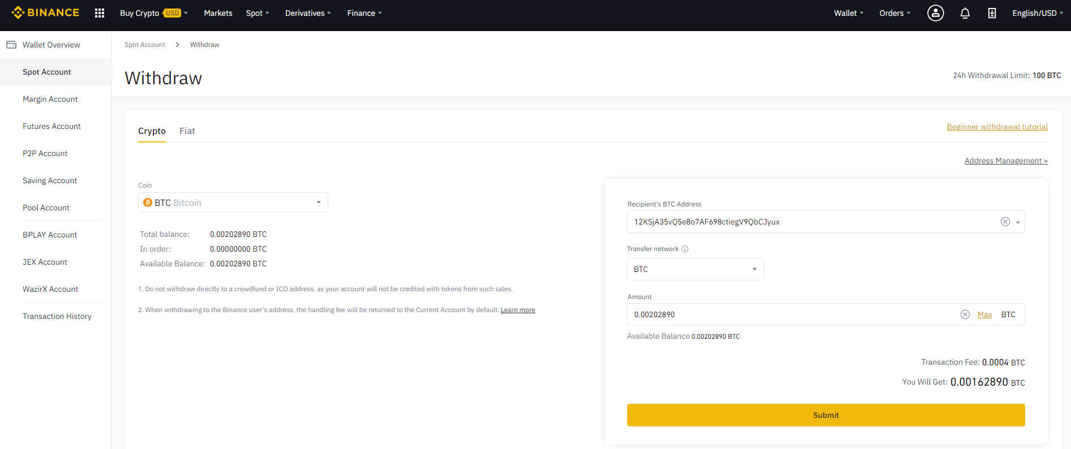

CRYPTORESEARCHIST
6. Paste it into the recipient text box of your sender wallet,
choose the amount to send, then submit it

Slide 11
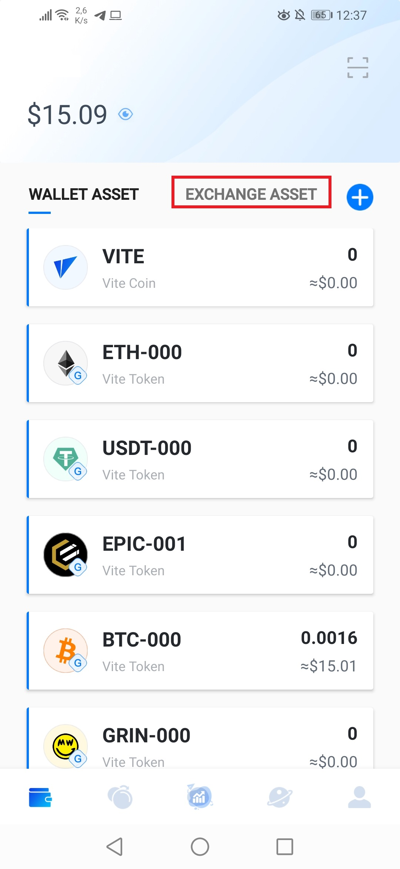
CRYPTORESEARCHIST
7. Confirm that you got your BTC by checking your Vite Wallet again.
Then tap on the “EXCHANGE ASSET” button:

Slide 12
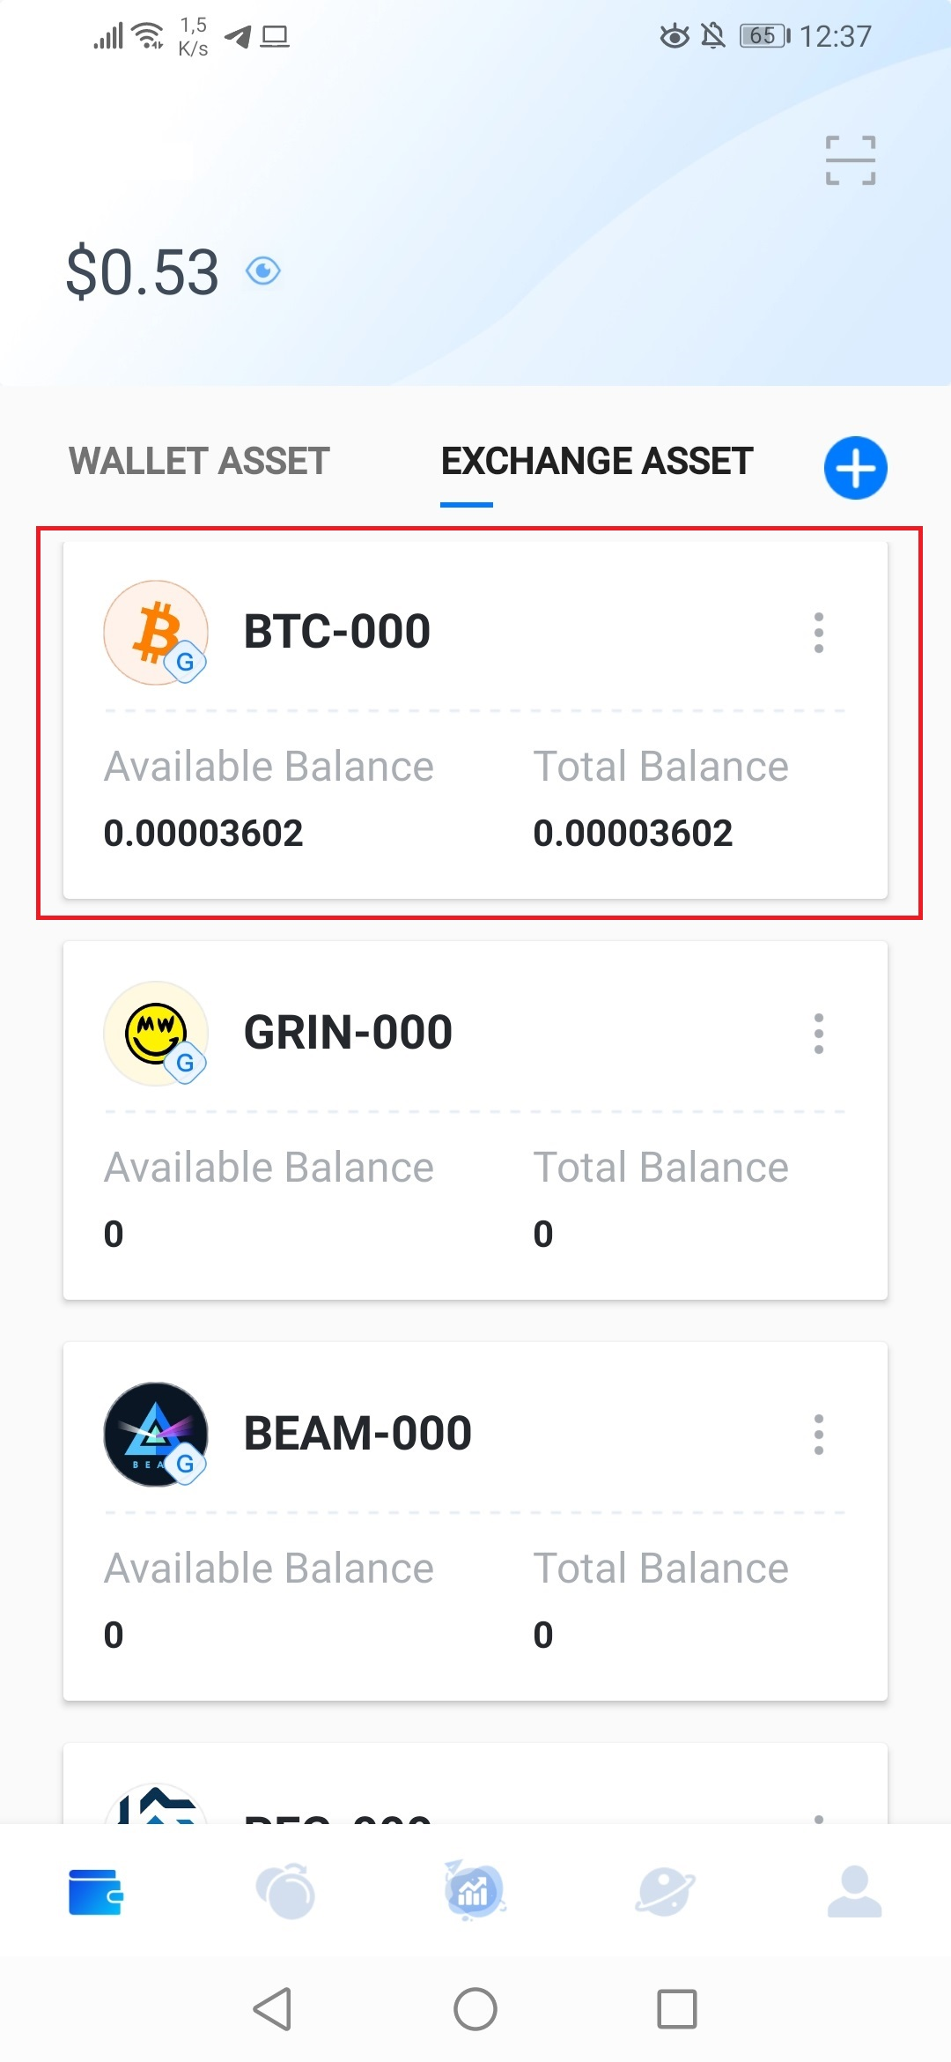
CRYPTORESEARCHIST
8. Tap the cryptocurrency you want to trade with,
in this case it will be BTC:

Slide 13
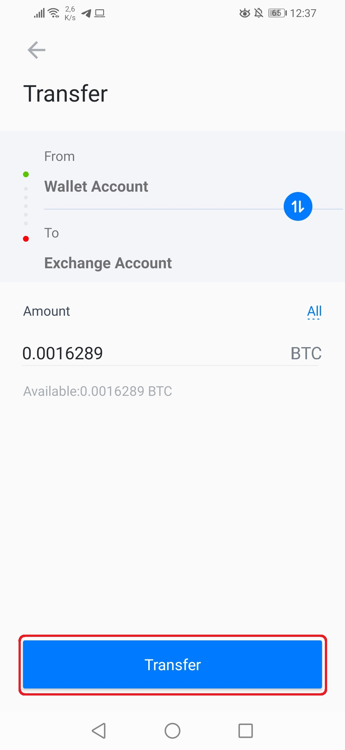
CRYPTORESEARCHIST
9. Choose the amount you want to trade with,
in this case it will be 0.0016289 BTC:

Slide 14
CRYPTORESEARCHIST
10. Tap “Transfer”

Slide 15
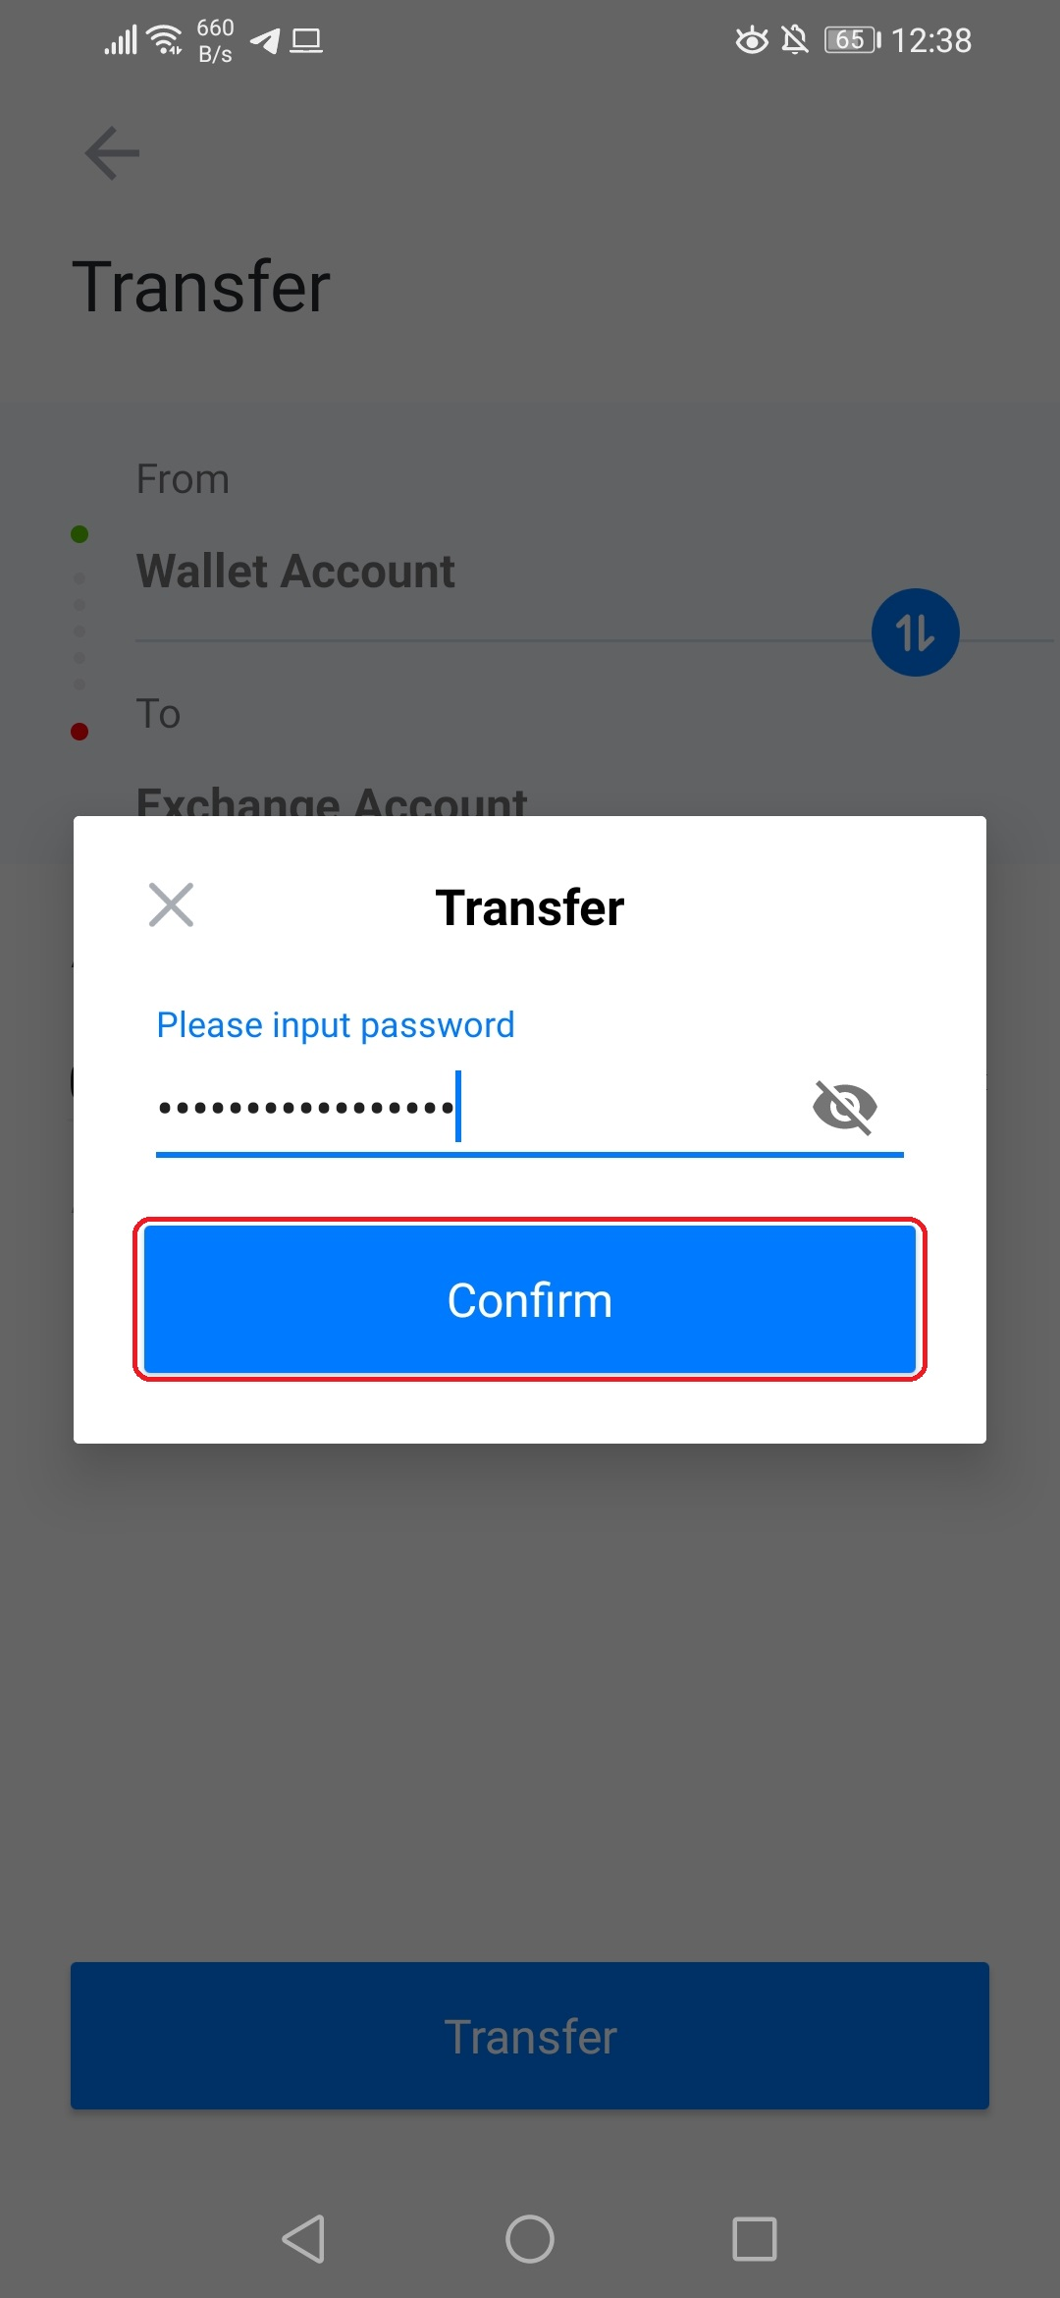
CRYPTORESEARCHIST
10. Type your password, then tap “Confirm”:

Slide 16
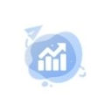
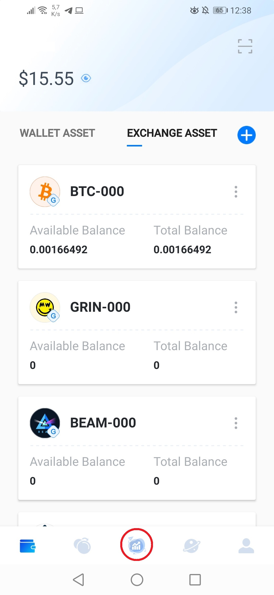
CRYPTORESEARCHIST
11. You are ready, now tap this icon:

Slide 17
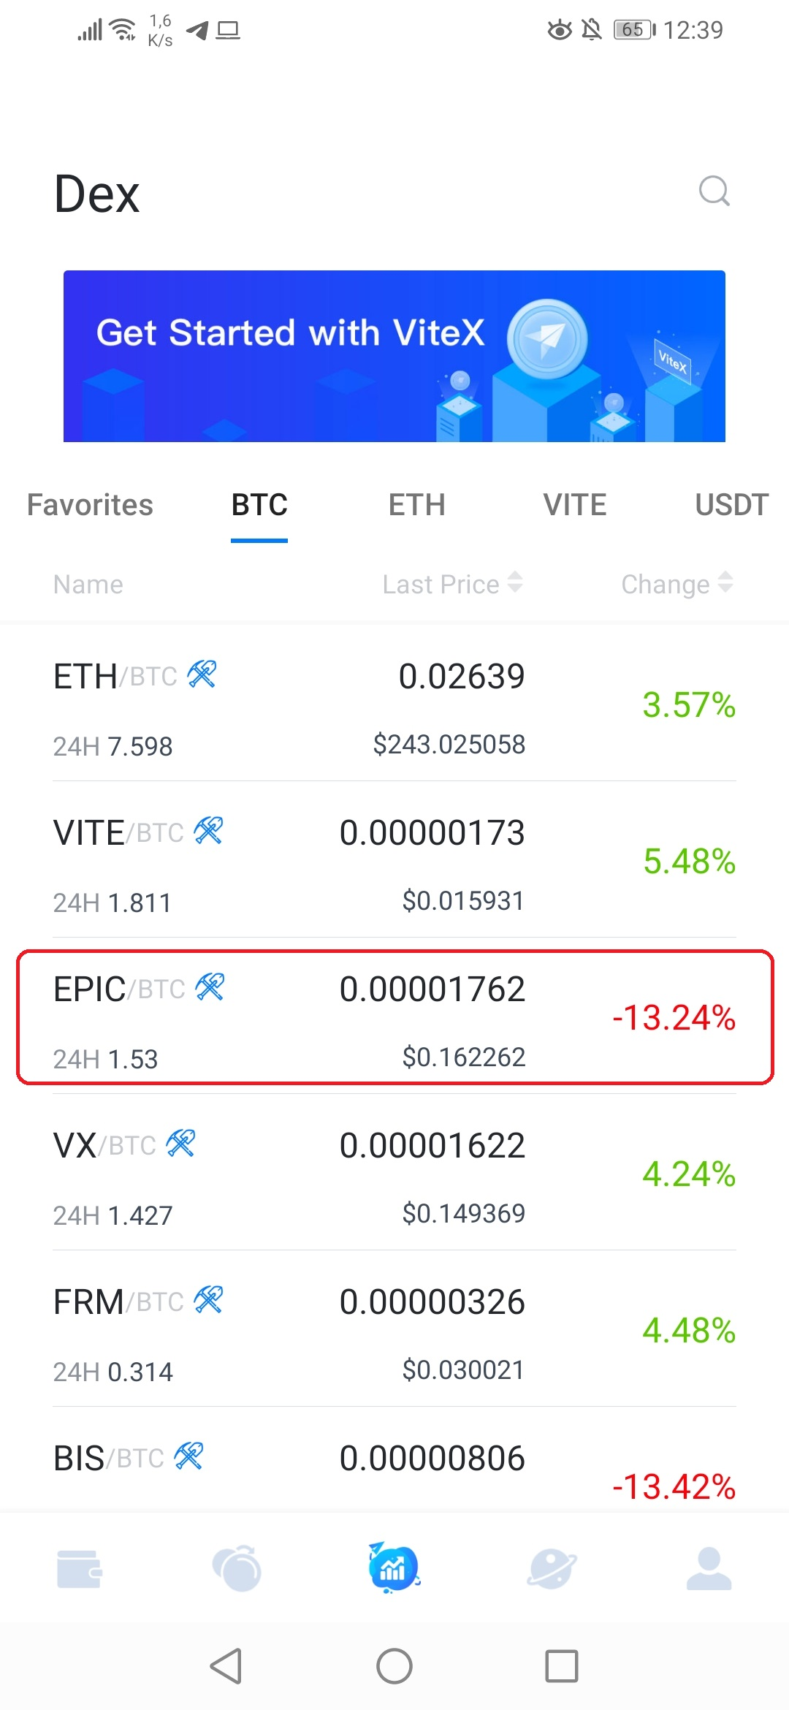
CRYPTORESEARCHIST
12. Choose a trading pair, for instance EPIC/BTC:

Slide 18
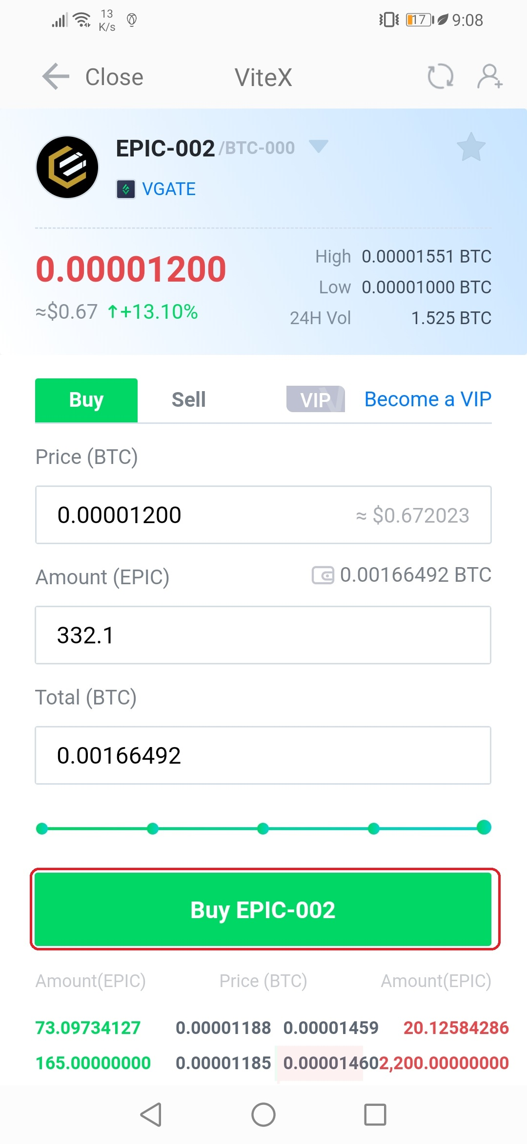
CRYPTORESEARCHIST
13. Set your buy price and the amount of BTC you
want to invest, then tap “Buy EPIC-002”:

Slide 19
CRYPTORESEARCHIST
13. Set your buy price and the amount of BTC you
want to invest, then tap “Buy EPIC-002”:

Slide 20
CRYPTORESEARCHIST
14. Type your password again, then tap “Confirm”:
15. Dojyaaa~~n!, a buy order has been placed, you
can cancel it by tapping on “Cancel”:
16. And finally for selling your coin, just tap the
“Sell” tab, and repeat the same process previously explained.

Slide 21



CRYPTORESEARCHIST
Feel free to follow me on my networks if you wanna learn more.
/Cryptoresearchist
/NoahVerner
/NoahVerner

